Slide 1
D-311 Unit 9: Daily Duties

Slide 2
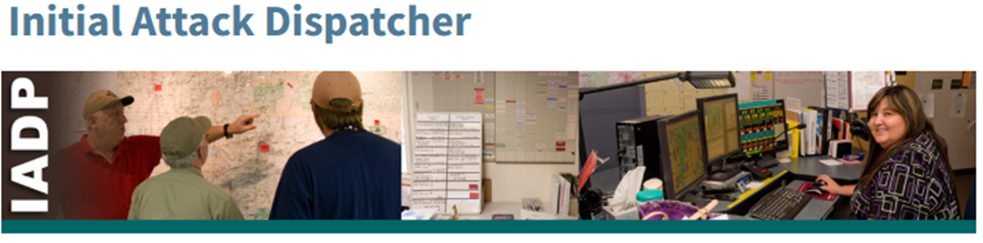
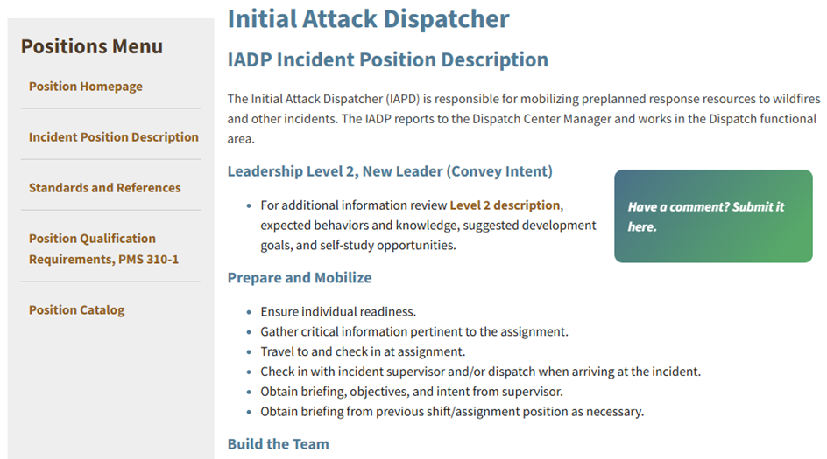
Incident Position Standards Alignment
https://www.nwcg.gov/positions/initial-attack-dispatcher

Slide 3
Objectives
Students will be able to :
1. Describe the daily dispatch office functions.
2. Describe the dispatching steps to implement a routine incident dispatch.
3. Describe the responsibilities of the IADP as they relate to implementing established emergency (non-suppression) dispatch plans.
4. Identify situations that increase dispatch complexity. Describe how these events/incidents affect you as an IADP and what local guides may be available to handle them.

Slide 4
Group Discussion – Daily Routines
What are some daily duties/routines of an IADP?
Weather
Situation reports
Resource tracking
Receive, record and relay messages
Staffing levels
Monitor dispatch systems & filing documents
On-Going incidents
Update intelligence information/boards
General information
Other duties as assigned

Slide 5
Group Discussion
What is the importance of timely and accurate information exchange?
What are some ways we share information?

Slide 6
Activity slide
Steps to implement a routine incident fire dispatch
New fire Incident report
Resource mobilization
Incident duties
Incident/resource demobilization

Slide 7
Group Discussion
Describe the responsibilities of the IADP when implementing non-suppression emergency dispatch plans?
Describe the steps for handling an incident within an incident (IWI)?

Slide 8
Group Discussion
What are situations/incidents that increase dispatch complexity?
What are the dispatcher’s responsibilities as situations escalate?

Slide 9
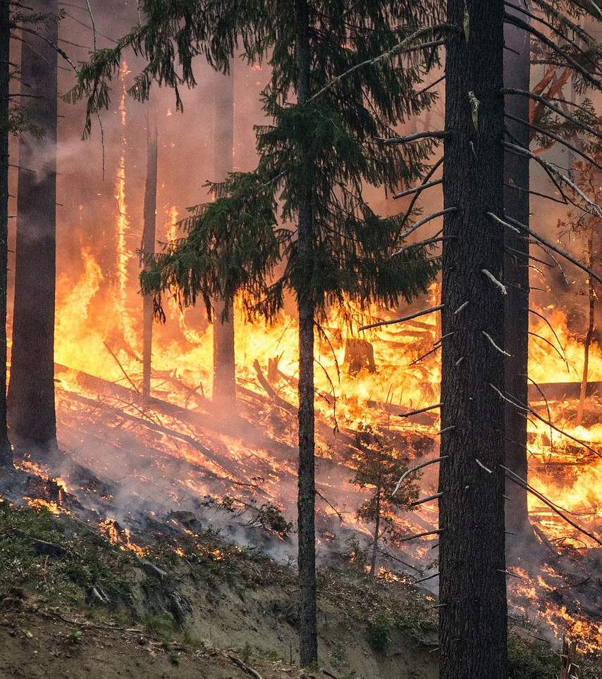
Knowledge Check
What are some daily duties of an IADP?
Answer:
Weather
Situation reports
Monitor radio traffic
Monitor dispatch systems
Update intel information/board

Slide 10
Summary
Students will be able to :
1. Describe the daily dispatch office functions.
2. Describe the dispatching steps to implement a routine incident dispatch.
3. Describe the responsibilities of the IADP as they relate to implementing established emergency (non-suppression) dispatch plans.
4. Identify situations that increase dispatch complexity. Describe how these events/incidents affect you as an IADP and what local guides may be available to handle them
Notes:
Guides and Key
The presentations and instructor guides include notes to aid facilitators in instruction.
Key
Indicates an action for the instructor to take.
Indicates topics and information for the facilitator to use as they see fit.
Example Notes
Review unit objectives.
Exercise
Advise participants that the next few slides will introduce common terms that describe parts of a fire.
Pre-Video Discussion
In this scenario, firefighters have arrived on scene of a new fire. They are gathering and communicating their situational awareness of the current fire behavior.
Play Video
Title Basic Fire Terminology
Summary State the summary
Time (02:20)
Audio
Post-Video Discussion
This unit will discuss many of these terms in more detail.
Question: Identify this fire behavior.
Answer: Torching
Note to Instructor
The fuel types listed on this slide will be discussed in detail in Unit 2.
List Level 1
List Level2
Example
Example
List Level 1
List Level 1

